Slide 1
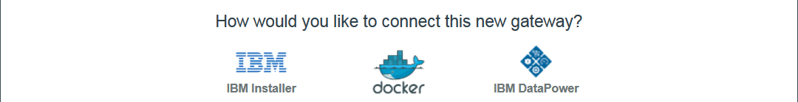
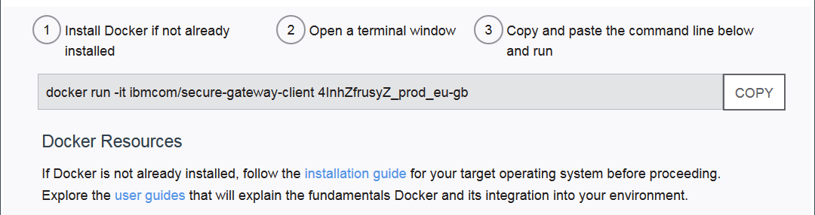
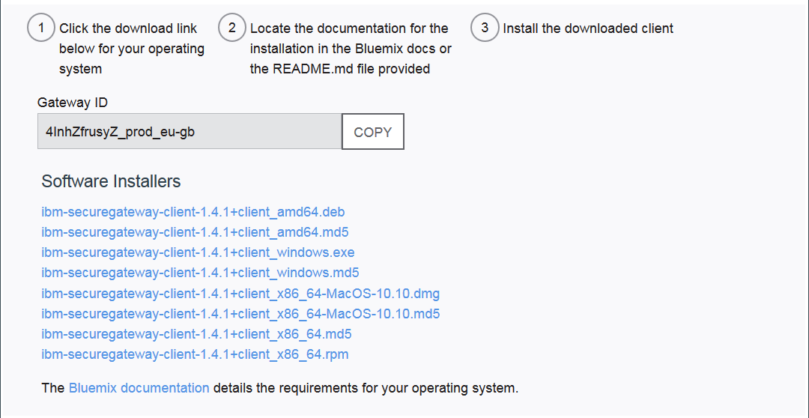
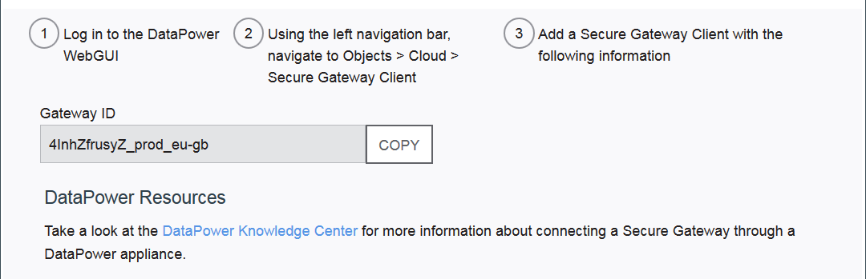
Client types
Recommended for production
Notes:
As mentioned earlier, secure gateway client resides inside the enterprise (on-premise). There are three mechanism to provide the client capabilities:
IBM installer, you install the client code for the supported Operating Systems (Windows, Linux, MacOS)
Docker container, which is the simplest to run provided you have a machine that is Docker ready
DataPower appliance provides a secure gateway client functionality

Slide 2
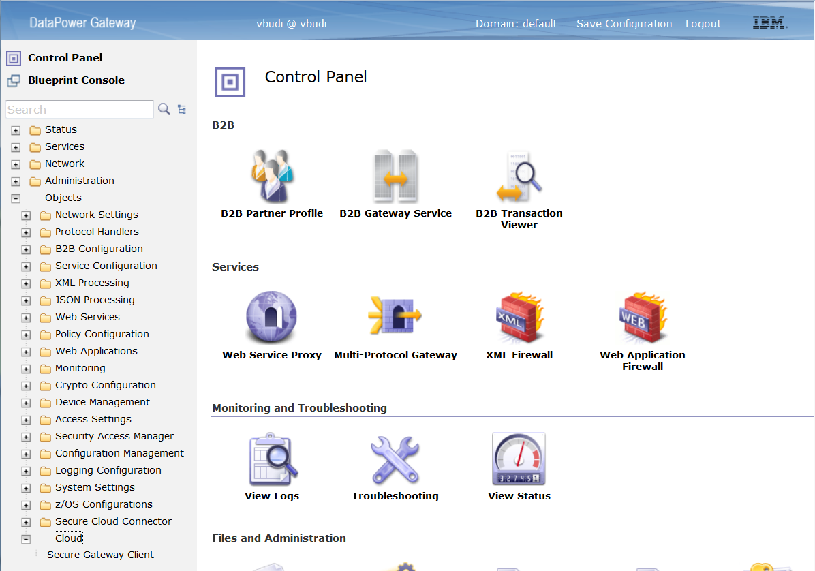
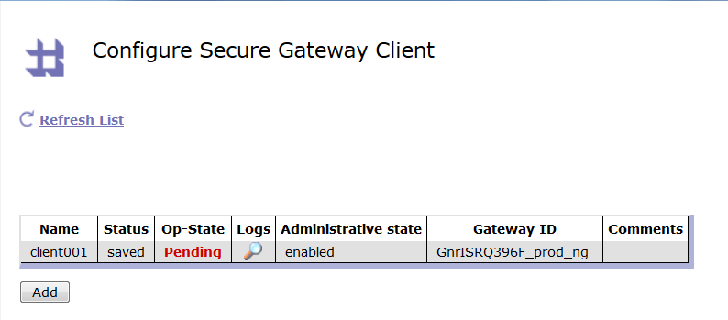
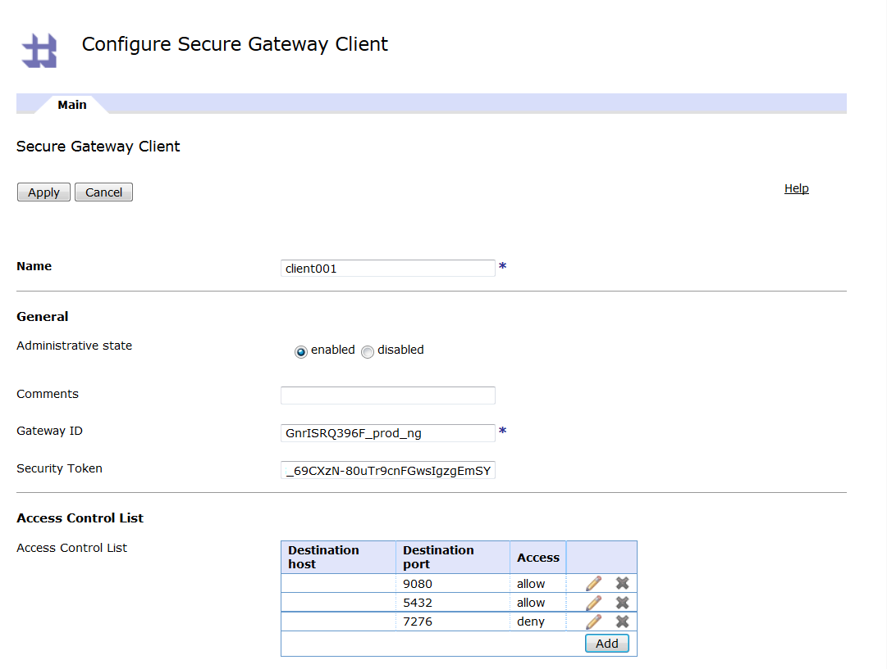
Secure Gateway client with DataPower appliance
This is the recommended option for a production environment
Notes:
In the DataPower appliance Web User Interface, login as an administrative user and select Objects > Cloud > Secure Gateway Client. You configure the gateway ID, Security Token and the Access Control List and click Apply.

Slide 3
Starting up the client
Docker:
docker run -it ibmcom/secure-gateway-client <options> <gateway_ID>
Windows:
<install_path>\ibm\securegateway\client\secgw.cmd <options> <gateway_ID>
windowsService.cmd install | uninstall
Linux:
node /opt/ibm/securegateway/client/lib/secgwclient.js <options> <gateway_ID>
sudo initctl start securegateway_client
systemctl start securegateway_client
Notes:
The docker container and the installer would have a sgenvironment.conf file to control the operation of the client. The secure gateway client runs as a node.js module. The docker container can be run using docker run -it ibmcom/secure-gateway-client command. While the installer method provides the startup depending on the platform.

Slide 4
Client arguments
Parameters and Arguments | Description
<gateway ID> | Gateway ID to connect to Bluemix
--F, --acl file <file> | Access control list batch file
--l, --loglevel <level> | Log level: ERROR, INFO, DEBUG or TRACE
--p, --logpath <file> | Direct logging to a specific file
--t, --sectoken <security token> | Security token to use for this gateway connection
--g, --gateway <hostname:port> | Manually select a specific gateway (advanced)
--multi | Runs in multiple-gateway mode (advanced)
Notes:
These are the command line arguments for the Secure Gateway client when you start it. These arguments can be used for both the Docker container or the IBM installer. These options can all be coded in the sgenvironment.conf file.

Slide 5
Client commands
Command | Description
acl allow <hostname>:port | Access control list allow
acl deny <hostname>:port | Access control list deny
no acl <hostname>:port | Remove an access control list entry
show | List current ACL list
status | Show current connection
ACL lets or blocks the client from connecting to a specific endpoint
Notes:
One important feature is the ACL (access control list). The client can define which host and port pairs that it is allowed to connect. The default is to deny all connection request from the secure gateway server. When the client starts, it reads from a file the appropriate ACL commands to allow or deny a set of host and port pairs.

